Slide 1


Classes and Object
Fundamental Computer Programming C++
Dr. Ihsan Ullah
ihsan@saturn.yzu.edu.tw
Office: 60913

Slide 2
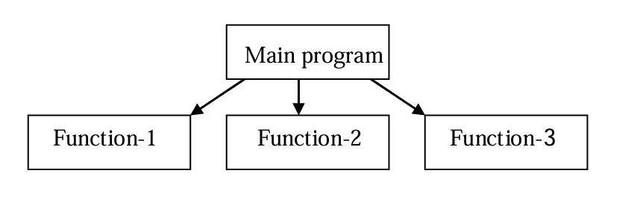
Procedure Oriented Programming
Approach where the program is viewed as a sequence of tasks (reading, calculation, printing, etc.).
Functions: Core components that define actions or steps for the program to execute.
Control Statements
2

Slide 3
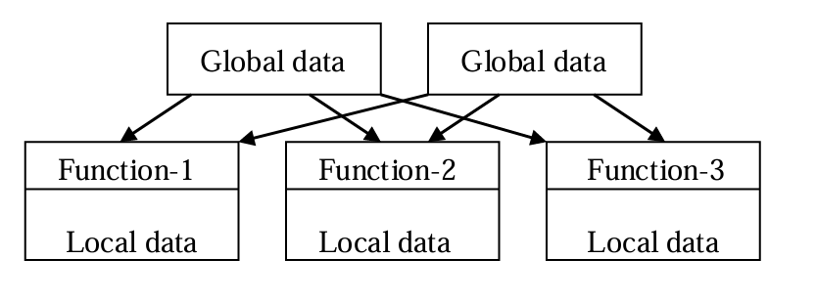
Procedure Oriented Characteristic
Problem Decomposition:
Breaks down the problem into smaller sub-tasks (procedures).
Functions as Central Elements:
Each task is implemented as a function.
Sequential Execution:
Functions are executed in a linear sequence.
Global Data Sharing:
Data is typically shared across functions, which can lead to issues with data security.
No Data Security:
Unlike OOP, data encapsulation is minimal, leading to less secure programs.
3

Slide 4
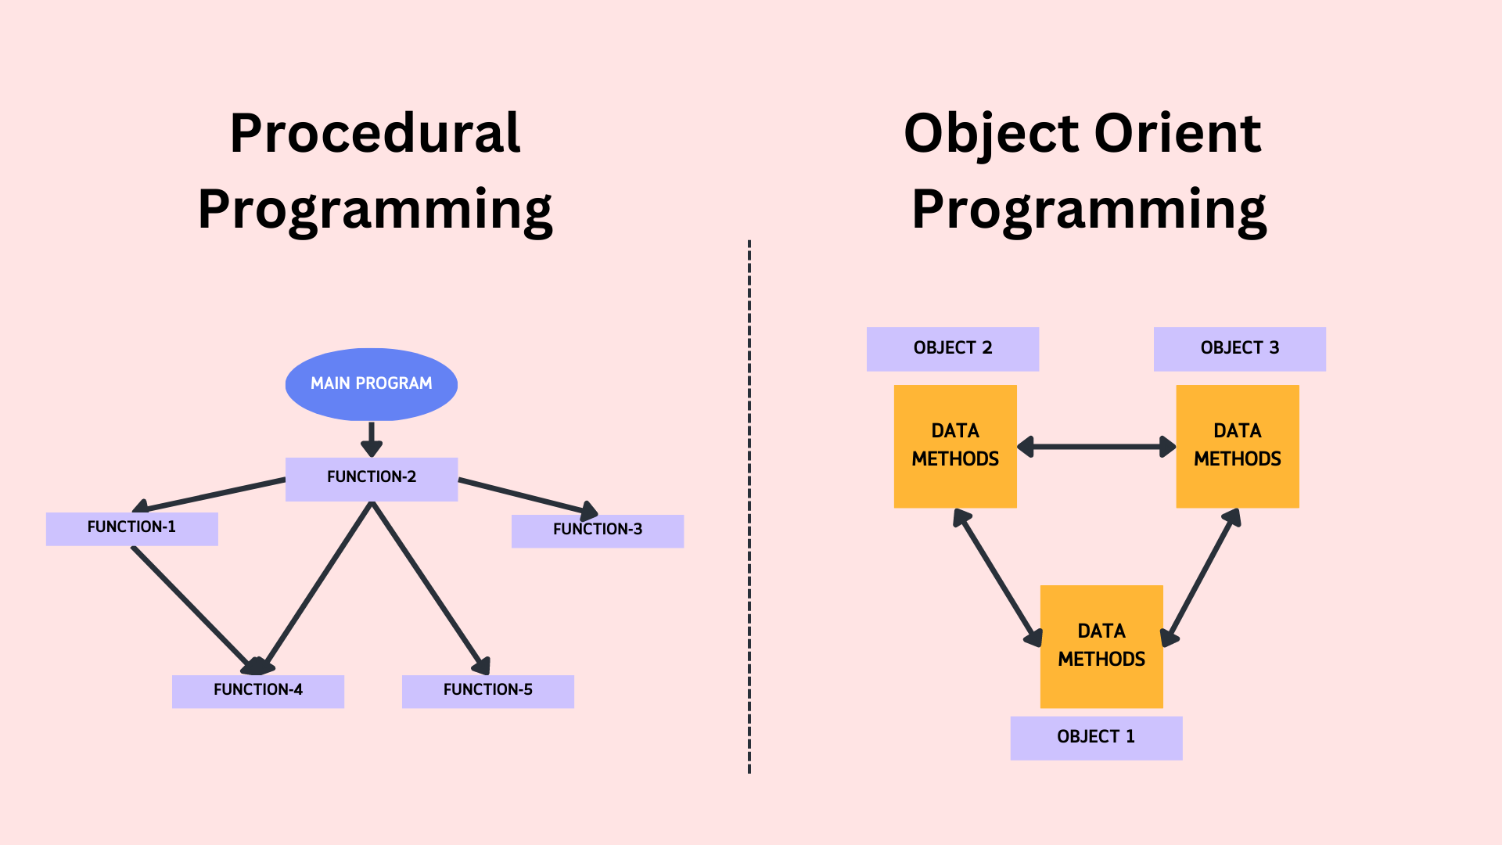
Object Oriented Programing (OOP)
Object-Oriented Programming (OOP) is a programming paradigm that uses objects and Classes
4

Slide 5
Why class and object are impotent?
Abstraction:
Classes provide a high-level view of data and behavior.
They hide complex implementation details, focusing on essential features.
Encapsulation:
Classes bundle data and methods together.
Encapsulation protects data from unauthorized access by using access specifiers like private and protected.
Reusability:
Once defined, classes can be reused to create multiple objects.
Promotes code reuse, reducing redundancy and improving maintainability.
5

Slide 6
Why class and object are impotent?
Inheritance:
Classes support inheritance, enabling the creation of new classes based on existing ones.
Facilitates code reuse and promotes hierarchical relationships between classes.
Polymorphism:
Classes enable polymorphism, allowing objects of different classes to be treated uniformly.
Achieved through inheritance and virtual functions, enhancing code flexibility and extensibility.
6

Slide 7
What is object
Objects in C++ are instances of classes, embodying tangible entities.
Classes act as blueprints for objects, specifying their structure and behavior.
Objects of the same class have a shared structure but unique data values.
7

Slide 8
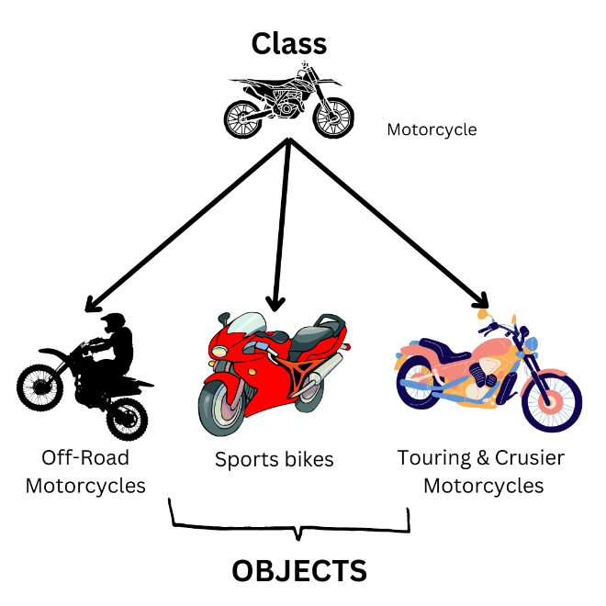
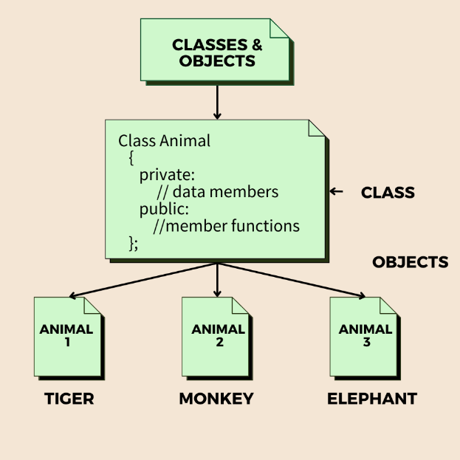
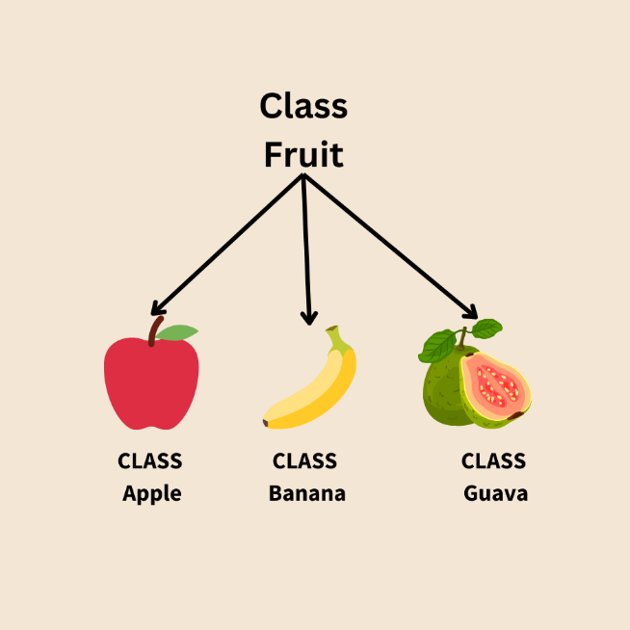
8

Slide 9
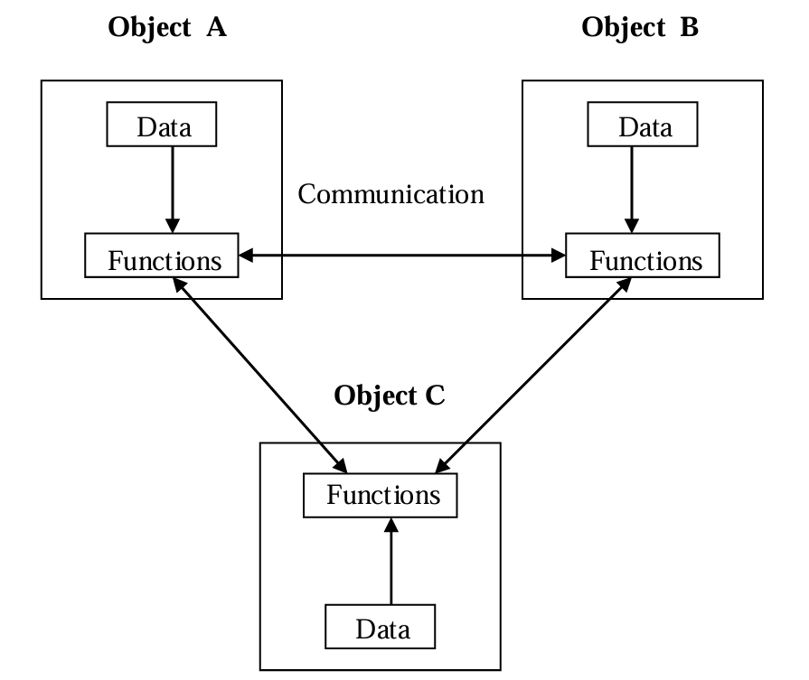
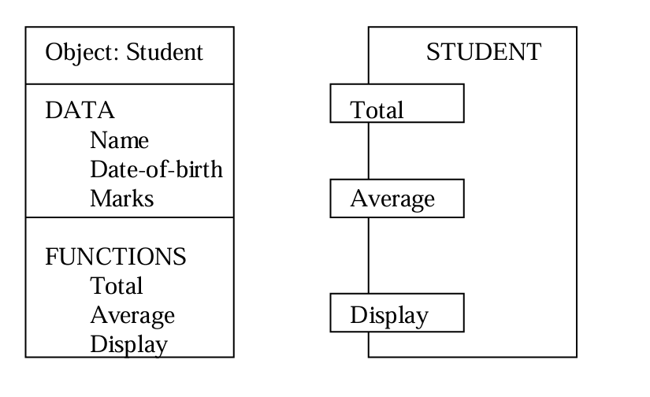
Object Oriented Programing (OOP)
9

Slide 10
Let's create a class name MyClass
class MyClass { // The class public: // Access specifier int myNum; // Attribute (int variable) string myString; // Attribute (string variable) };
The class keyword is used to create a class called MyClass.
The public keyword is an access specifier,
Inside the class, there is an integer variable myNum and a string variable myString.
10

Slide 11
What is classes and Object
A blueprint for creating objects that defines their structure and behavior.
Example:
class Car
{
public:
string brand;
string model;
void display()
{
cout << brand << " " << model << endl;
}
};
Car myCar;
myCar.brand = "Toyota";
myCar.model = "Corolla";
myCar.display();
Class
Object
11

Slide 12
Let's create an object from class
To create an object of MyClass, specify the class name, followed by the object name.
To access the class attributes (myNum and myString), use the dot syntax (.) on the object:
class MyClass { // The class public: // Access specifier int myNum; // Attribute (int variable) string myString; // Attribute (string variable) }; int main() { MyClass myObj; // Create an object of MyClass // Access attributes and set values myObj.myNum = 15; myObj.myString = "Some text"; // Print attribute values cout << myObj.myNum << "\n"; cout << myObj.myString; return 0; }
12

Slide 13
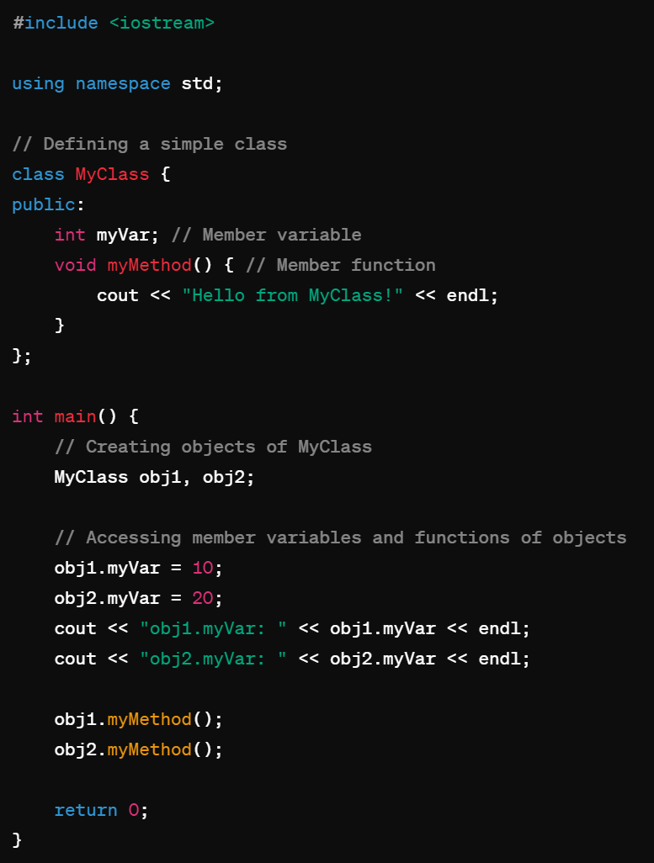
Creating Objects:
Instantiating objects from a class:
We define a class MyClass with a member variable myVar and a member function myMethod().
In main(), we create two objects obj1 and obj2 of type MyClass.
We access the member variable myVar and assign values to it for each object.
We call the member function myMethod() for each object.
Finally, we output the values of myVar for each object.
13

Slide 14
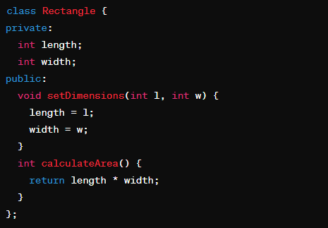
Class Members:
Data members: Variables declared within the class to store data.
Member functions: Functions declared within the class to perform operations on the data.
Control Statements
14

Slide 15
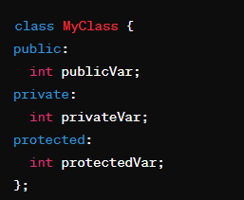
Access specifiers:
Public: Accessible from outside the class.
Private: Accessible only within the class.
Protected: Accessible within the class and its subclasses.
15

Slide 16
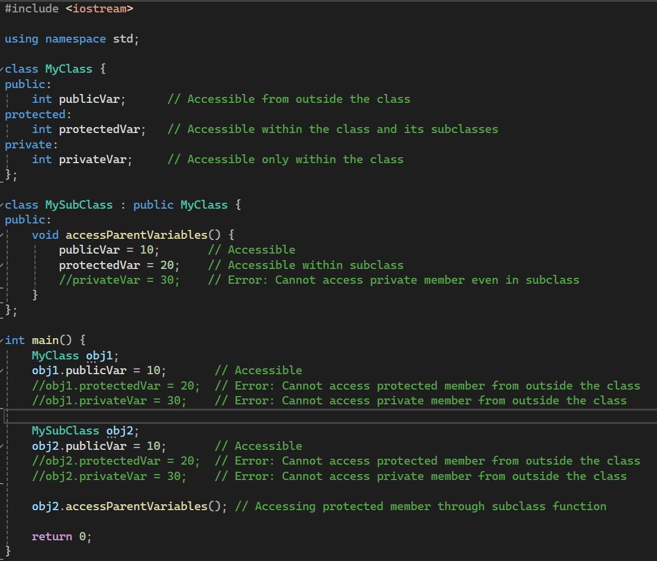
Class Members:
16

Slide 17
Constructors
A constructor is an instance function of a class.
However, it is very special.
A constructor will be invoked automatically when the object is created.
It must be invoked.
It cannot be invoked twice.
It cannot be invoked by the programmer manually.
Usually it is used to initialize the object.
17

Slide 18
Destructors
A destructor is invoked right before an object is destroyed.
– It must be public and have no parameter.
The compiler provides a default destructor that does nothing.
To define your own destructor, use ~:
18

Slide 19
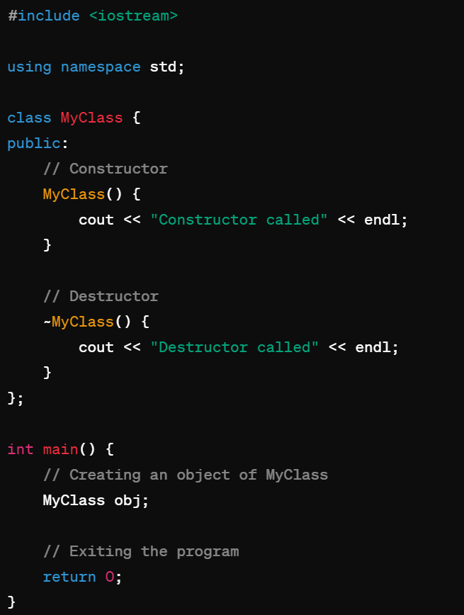
Constructors and Destructors
Special member functions automatically called when an object is created.
Used to initialize object's data members and set up its state.
Have the same name as the class.
Can be overloaded, allowing multiple constructors with different parameter lists.
19

Slide 20
Instance vs. static variables
In a class, we can define variables and functions.
They are call member variables and member functions.
However, now there can be four types of class members:
Instance variables (default).
Static variables.
Instance functions (default).
Static functions.
Starting from now, when we say member variables (fields) and member functions, we are talking about instance ones.
20

Slide 21
Instance and static variables
Instance Variables:
Variables unique to each object, holding data specific to that instance.
Static Variables:
Variables shared among all objects of the class, containing data common to all instances.
21

Slide 22
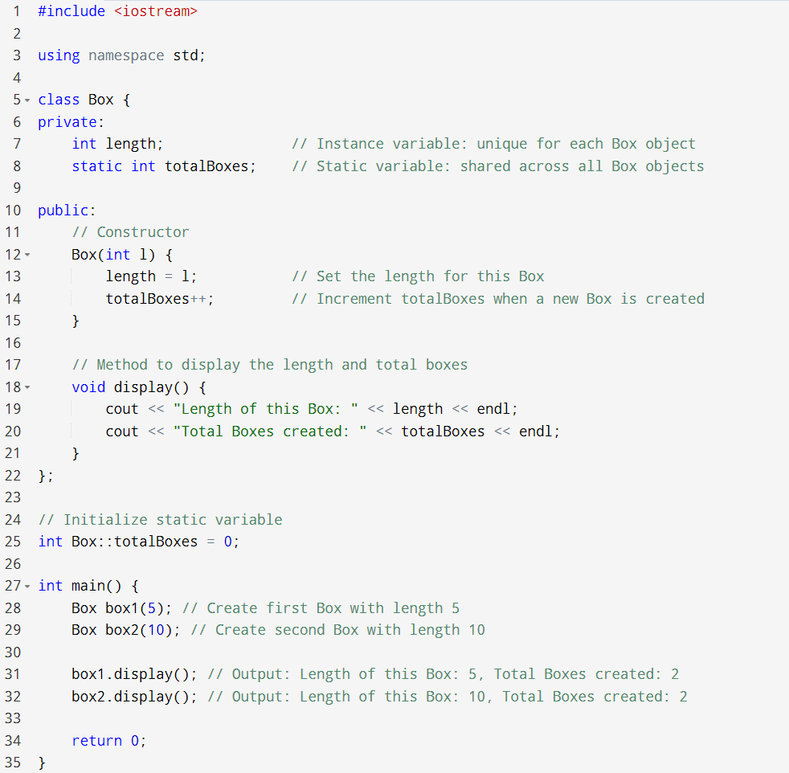
22

Slide 23
Visibility
We can/must set visibility of members in a class:
Public members can be accessed anywhere.
Private members can be accessed only in the class.
Protected members will be discussed later in this semester.
These three keywords are the visibility modifiers.
By default, all members’ visibility level is private.
Usually all instance variables are private.
23

Slide 24
Assignment 2
Create a class Student with attributes name, marks (for 5 subjects), and a method to calculate and return the grade based on average marks. Implement a grading system as:
90-100: A
80-89: B
70-79: C
60-69: D
Below 60: F
Write a C++ program that demonstrates the use of the three access specifiers: public, protected, and private.
Create a class named Rectangle that includes private member variables for length and width. Implement methods to set the dimensions, calculate the area, and calculate the perimeter of the rectangle.
Write a C++ program that creates several Book objects and displays their information along with the total number of books using constructor.
Write a C++ program that defines a class Employee with attributes for name, id, and department. Create multiple Employee objects and display their details along with the total number of employees created.

Slide 25
Thanks
Any Question?

